Slide 1

Recap Forecast Techniques
Osei-Tutu Desmond

Slide 2
The Forecast Process
Data Collection and Monitoring
Data Processing and Manipulation
Forecast Products

Slide 3
Forecast Types
Marine Forecast
Aeronautical Forecast
Public Weather Forecast

Slide 4
Forecasting Products
Pressure
Wind at different pressure levels
ITB

Slide 5
What to look for on Pressure Charts
High Pressure Areas
Low Pressure Areas
Ridges
Trough
Pressure Tendency
Pressure Gradient

Slide 6
Wind Charts
Cyclonic Vortices or flows
Anticyclonic Vortices or flows
Source of Wind
Direction and Speed of the Wind
Directional or Velocity Convergence
Diverging winds

Slide 7
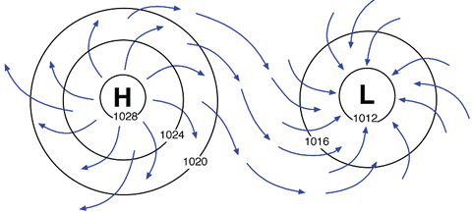
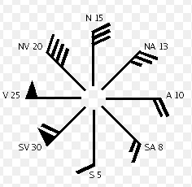
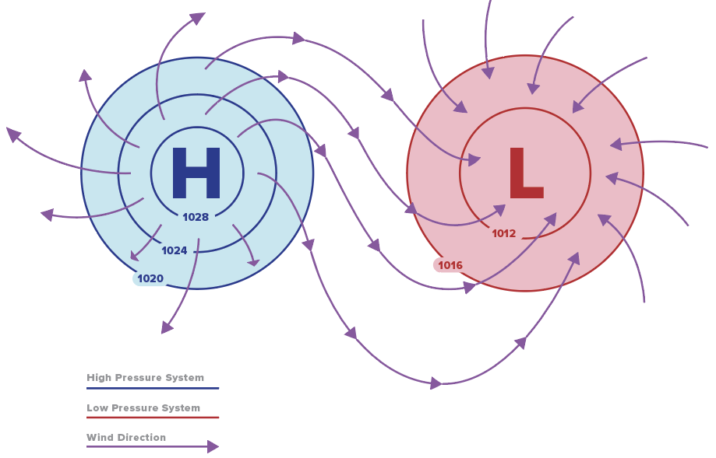
Wind Dynamics

Slide 8
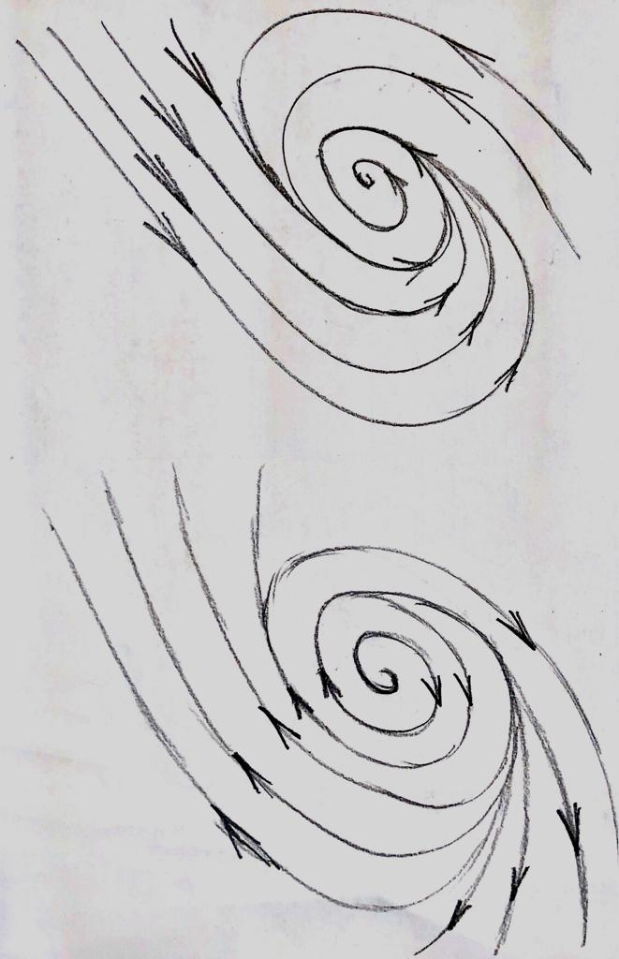
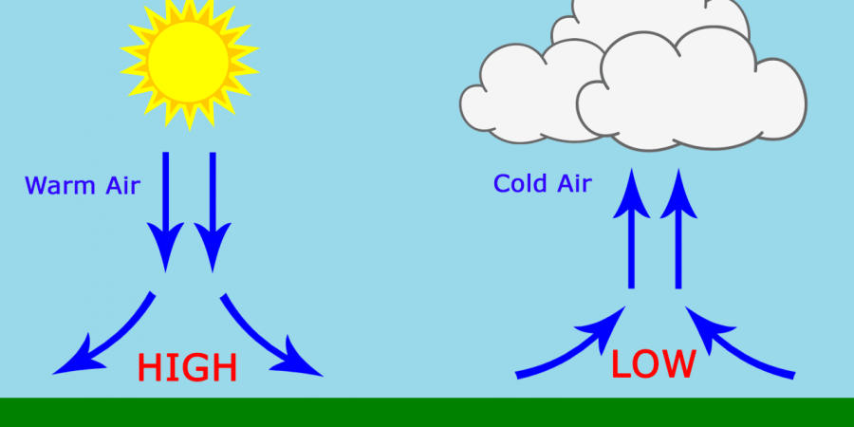
Cyclonic and Anticyclonic
C
A

Slide 9
Winds at Standard Pressure Levels
925 hPa
850 hPa
700 hPa
600 hPa
200 hPa
100 hPa
Low levels
Mid levels
High levels

Slide 10
Take Homes
Low level | Mid level | Description
Convergence | Convergence | Deep convergence
Convergence | Divergence | Shallow convergence
Low level | Mid level | High level | Inference
Cyclonic | Cyclonic | Anticyclonic | Unstable
Cyclonic | Anticyclonic | Anticyclonic | Conditionally unstable
Anticyclonic | Anticyclonic | Cyclonic | Stable
Cyclonic | Cyclonic | Cyclonic | Unstable

Slide 11
ITB
Estimated position of the ITB
° 15°C dew point temperature / Surface winds
° Line of symmetry through troughs
° Satellite images
Weather zones of the ITB
Rate of increase or decrease from previous position or subsequent estimates.

Slide 12
Satellite Monitoring
Type of channel
Time of Day and feature to look for
Season
NB: Always animate satellite images

Slide 13
Satellite Channels
Primary or Basic Channels
RGBs

Slide 14
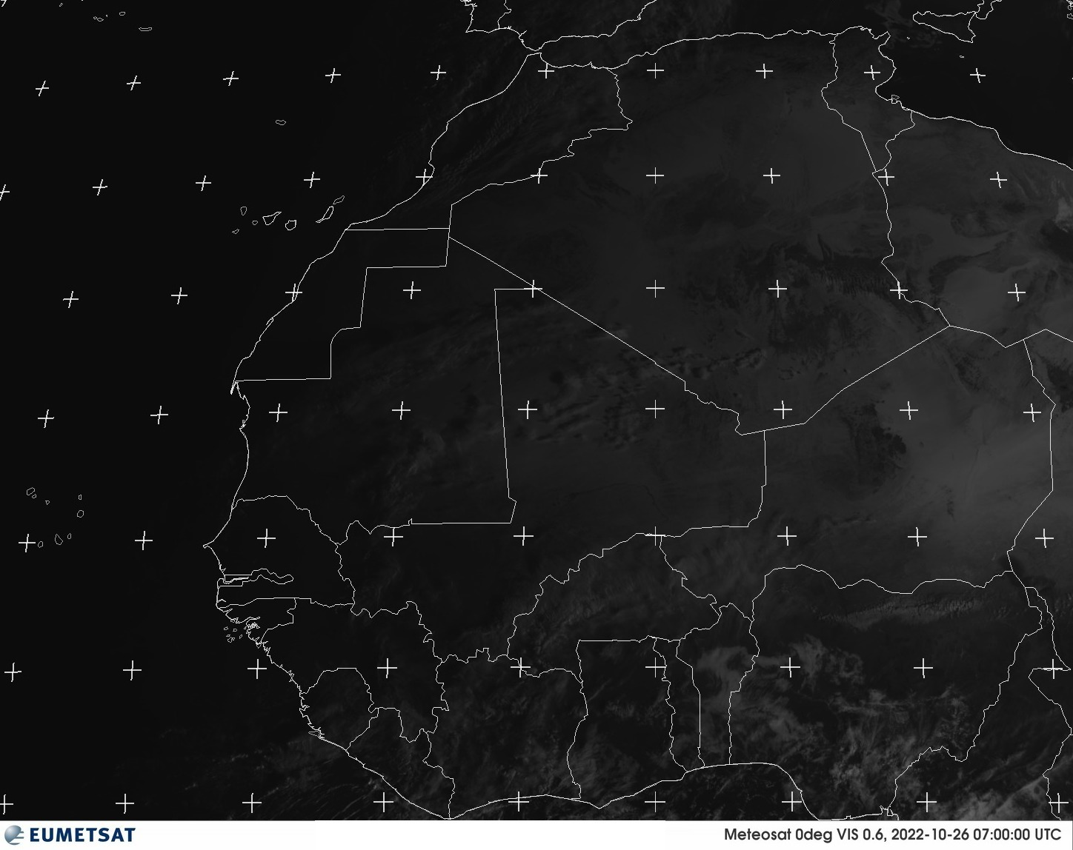
Visible

Slide 15
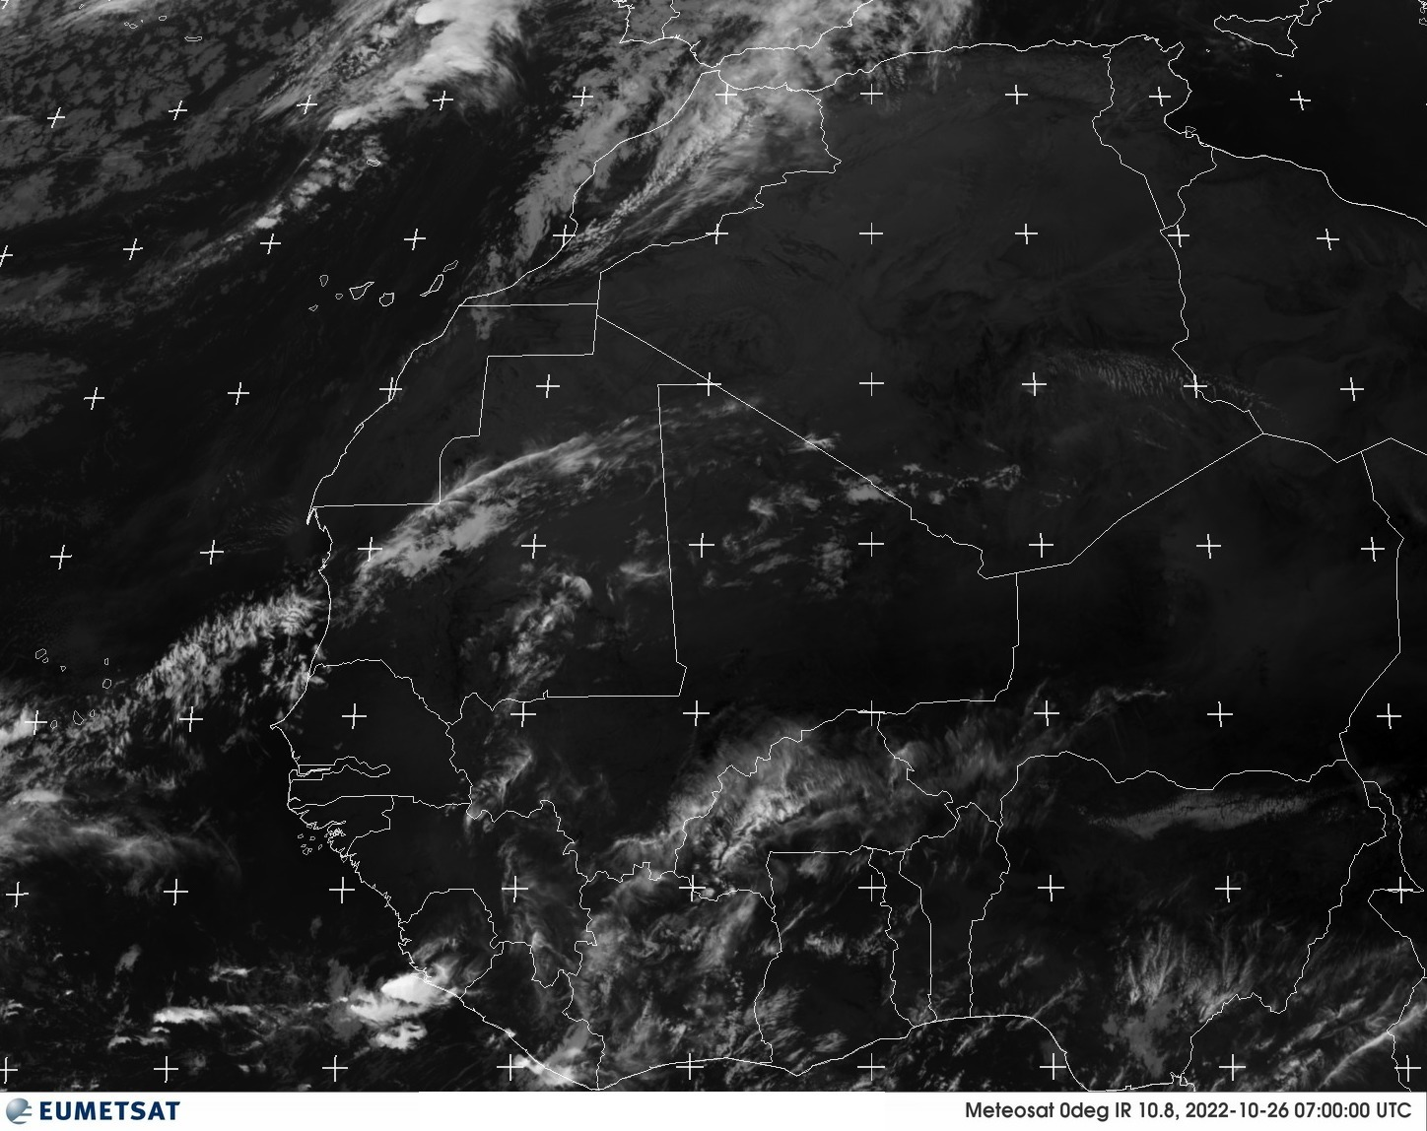
Infrared

Slide 16
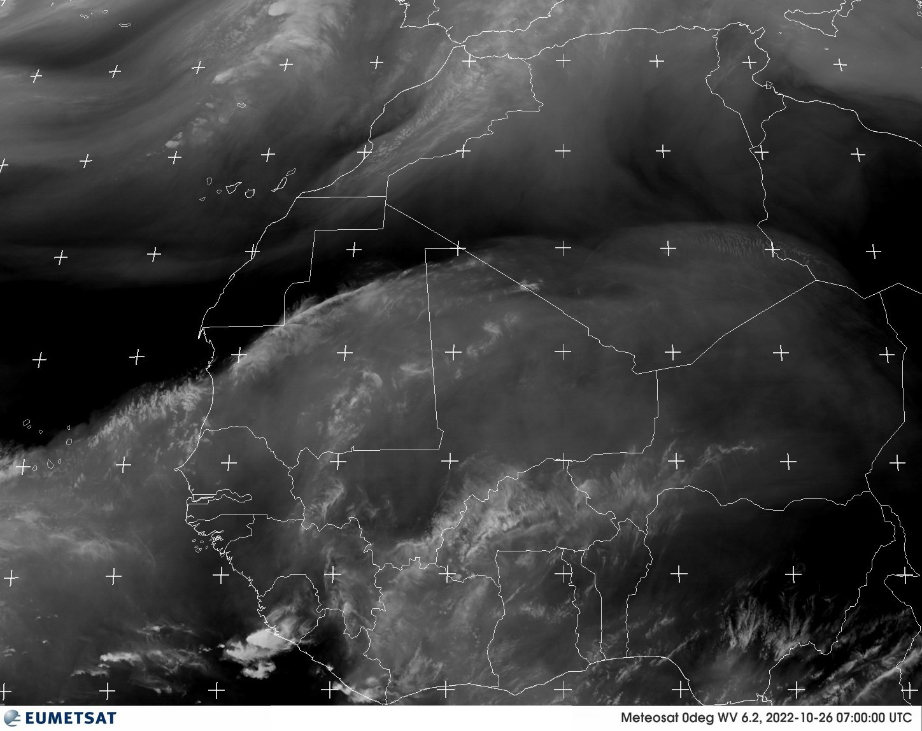
Water Vapor

Slide 17
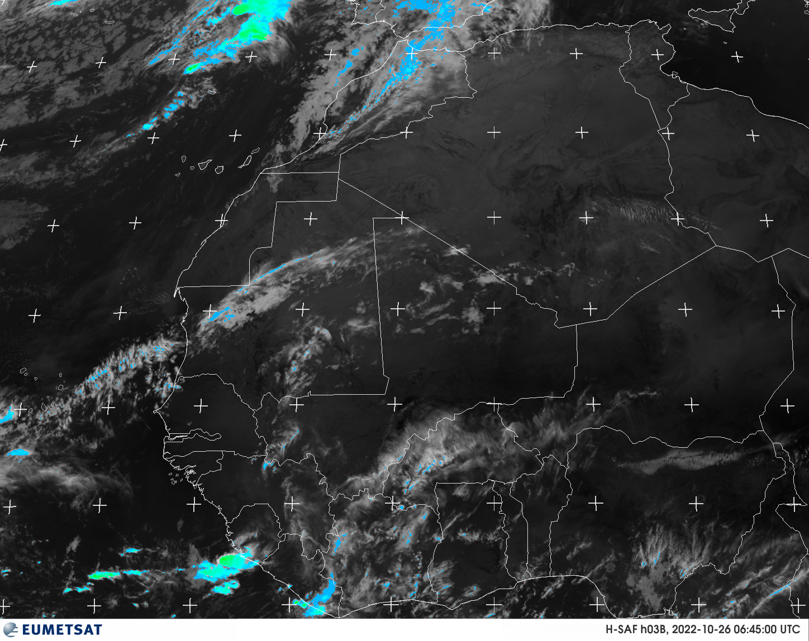
H-SAF HO3B

Slide 18
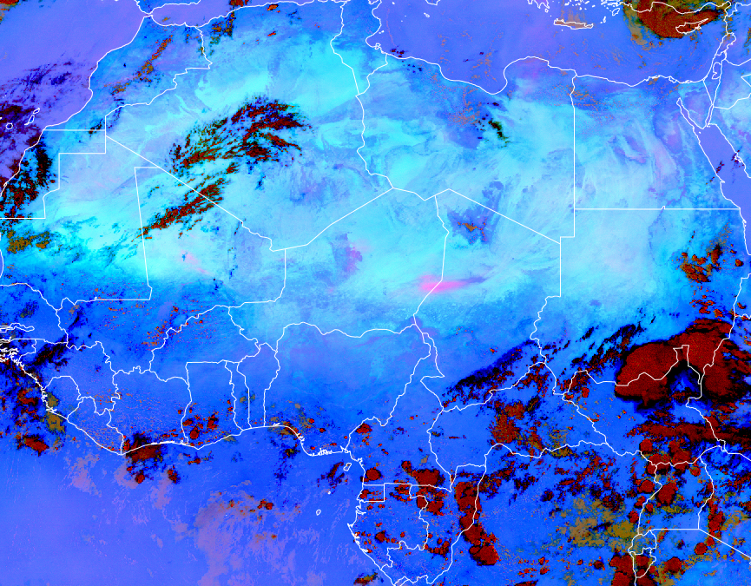
DUST

Slide 19
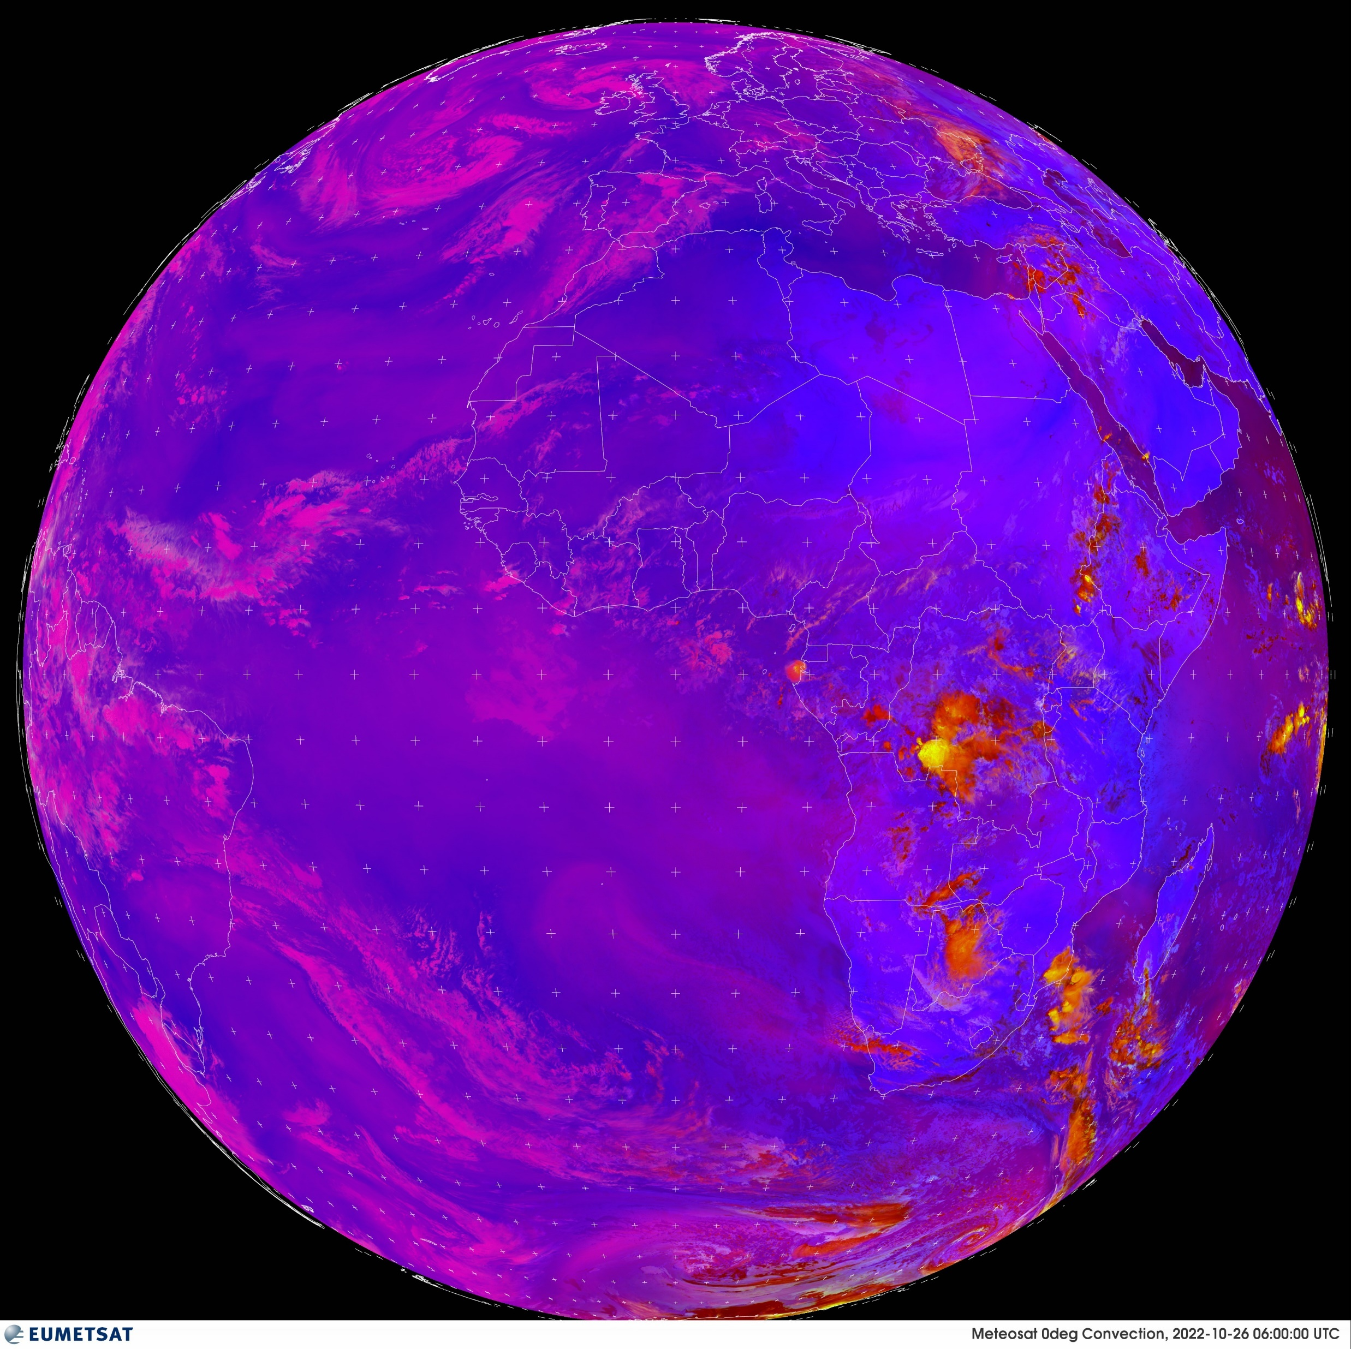
CONVECTION

Slide 20
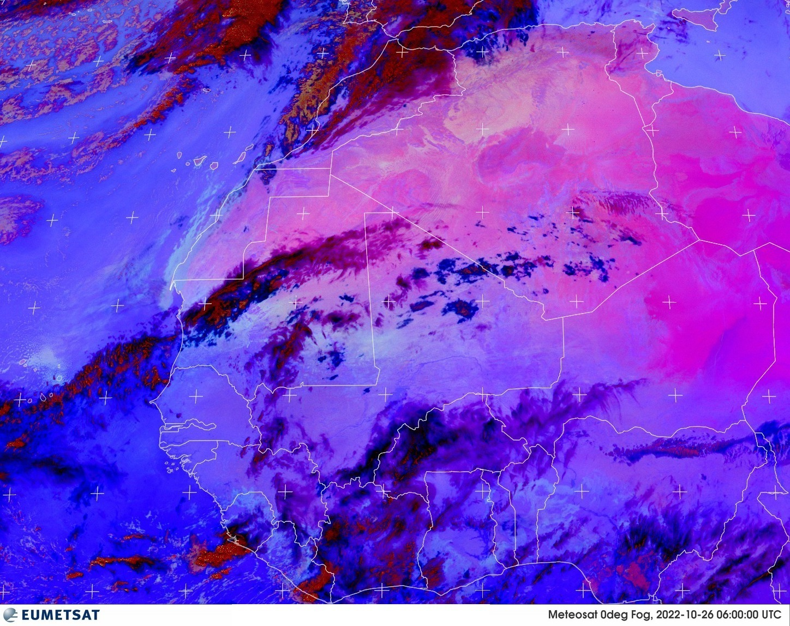
FOG

Slide 21
Satellite Sites
windy.com
view.eumetsat.int

Slide 22
Surface Verification
synop messages - www.ogimet.com
aeronautical reports - https://aviationweather.gov/metar

Slide 23
Thank you

